Slide 1

Team Members -
Ismail Asorona (Team Lead)
Ezeogu Glory
Gbolahan Afolabi
Mecahel Demissie
Boluwatife Shekoni
Emmanuel Yormesor

Slide 2

Agenda
Part 1: Introduction
Part 2: Goal & Task
Part 3: Algorithm
Part 4: Diagram of Solution
Part 5: Source code
Part 6: References

Slide 3
Introduction
Purpose: This research aims to develop a solution that will better manage the movement of energy systems between transactive energy systems.
Solution: We developed a program that will utilize blockchain to create a secure communication between the energy company and the end-user without the use of an intermediary.
Real World Application: Blockchain based Transactive Energy Systems will automate checks and balances of energy consumption within a network that is validated by everyone which makes it a decentralized ledger.

Slide 4
Goals
Task
Goals & Task
Successfully develop a software that can safely secure the movement of energy systems between blocks
Create secure communication between the energy and the end-user
Create a blockchain that accepts energy input from multiple sources and distributes it after
This group will be writing a program for the blockchain The foremost language you can choose to step into the blockchain arena is Java. Python is fast becoming the most popular programming language in the world and if you are a new developer with experience in Python, then it might be the best Blockchain language for you.

Slide 5
Algorithm
Bold = Method
Import packages (hash, time, json)
Create block constructor class
Set block number, name, energy source, location, energy input, timestamp, and present hash
Create a function to get the previous block in blockchain list
Return list of blockchain decremented by 1
Create a function to add a block to blockchain list
Verify if block is valid
If valid send to mine method
Create function to calculate hash using sha256
Get block string
Return hash to present hash
Create a function to mine block to show record in blockchain list
List the mine blocked, nonce, block number, the input of the user and timestamp
Create function to print hashes
Print previous and current hash
Get blockchain length
Get index of block
Determine if block is verified
Create blockchain constructor class
Create list of blockchain
Get previous hash
Input state of the user
If the user state is not valid, no access to program
Create bank of how much energy is stored
Input choice of buying, selling, or quit the program
Input name, location, energy source, and amount of energy input
Print block record, and blockchain length
Create default block with default values
Calculate default block hash
Add default block to blockchain list

Slide 6
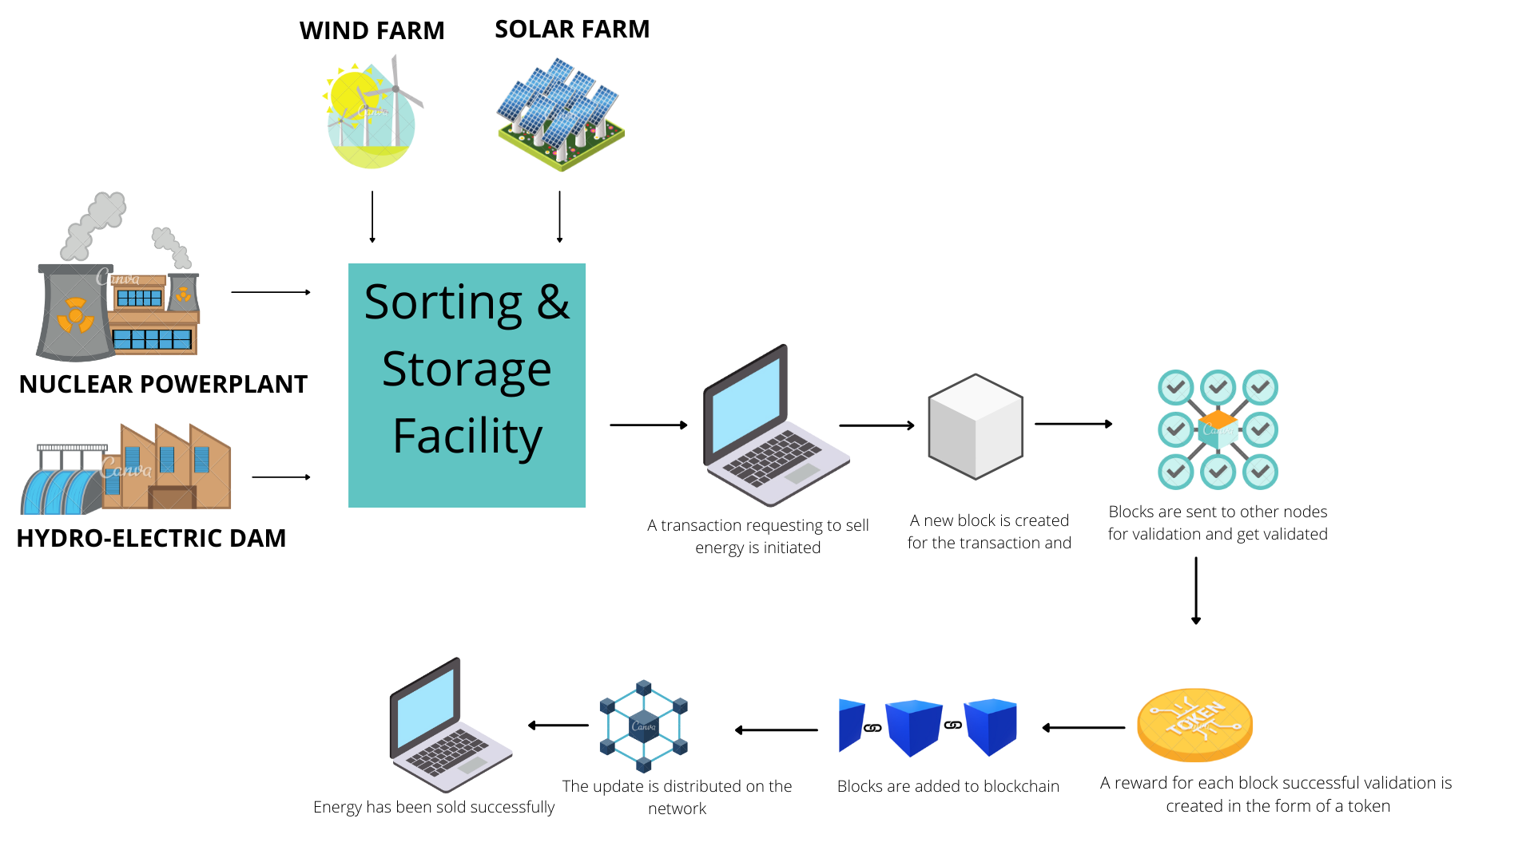
Diagram of Solution

Slide 7

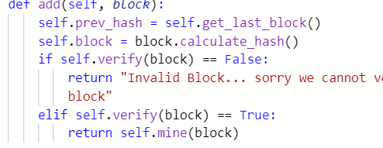
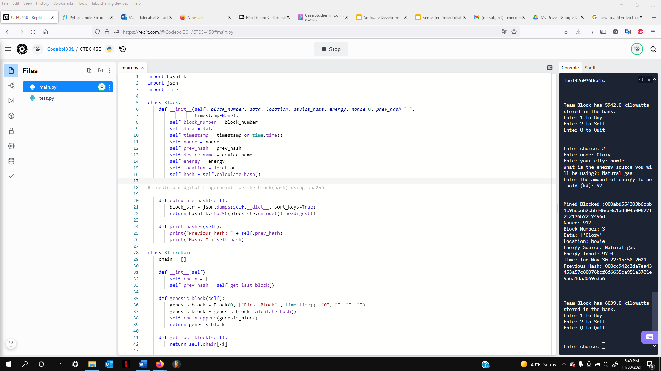
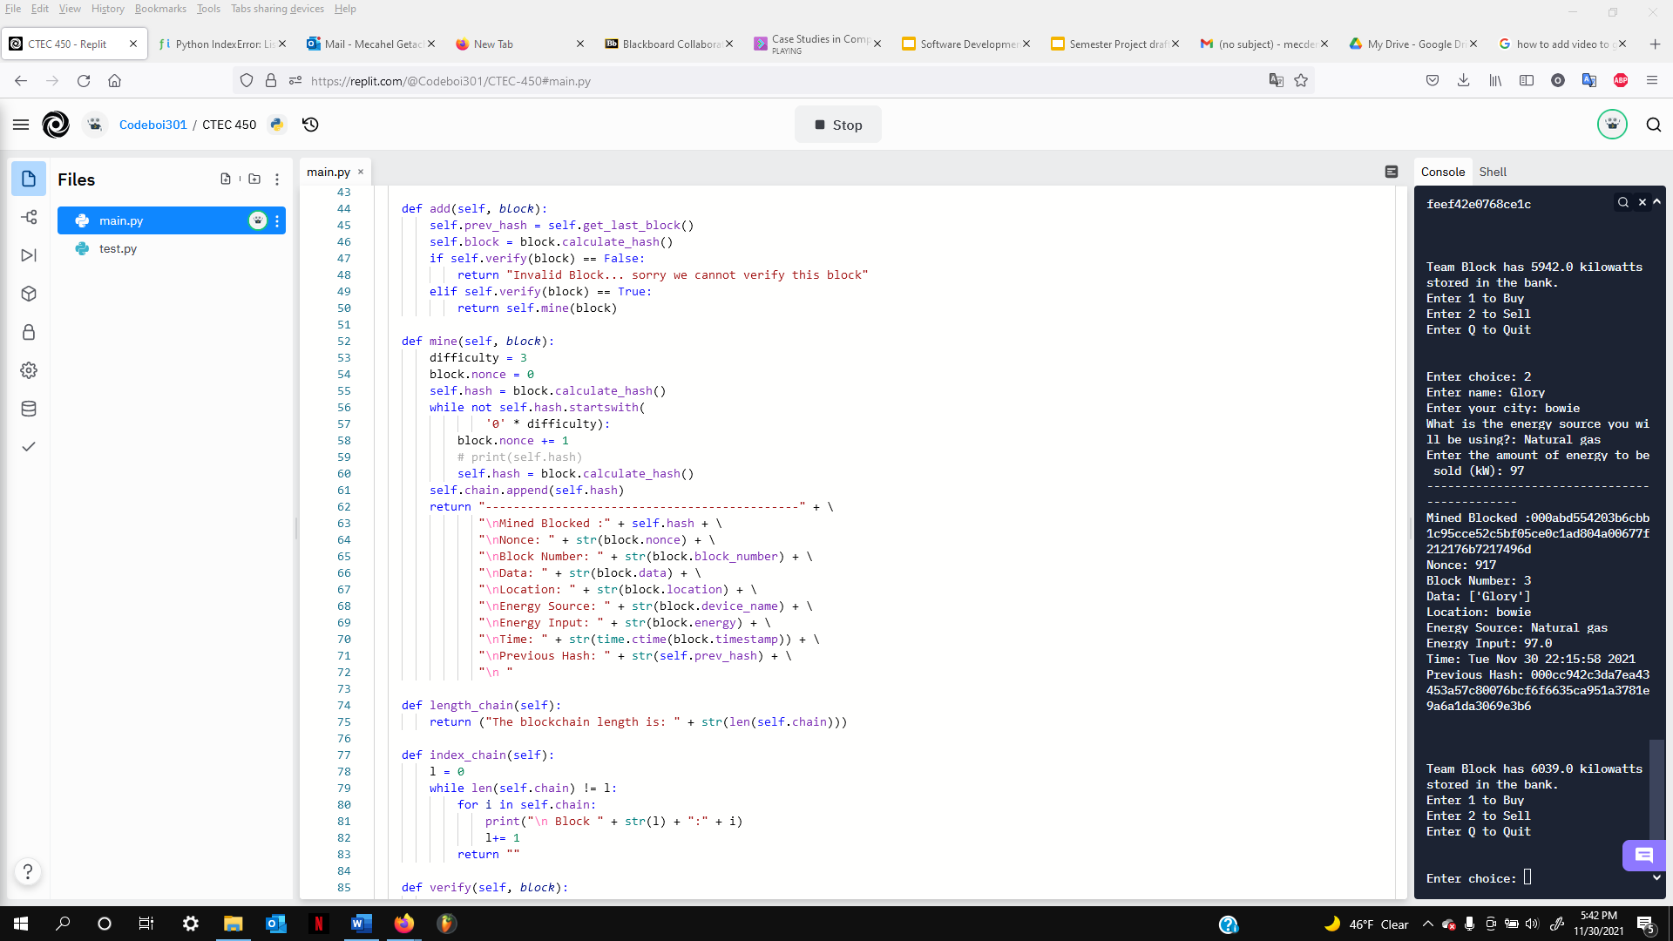

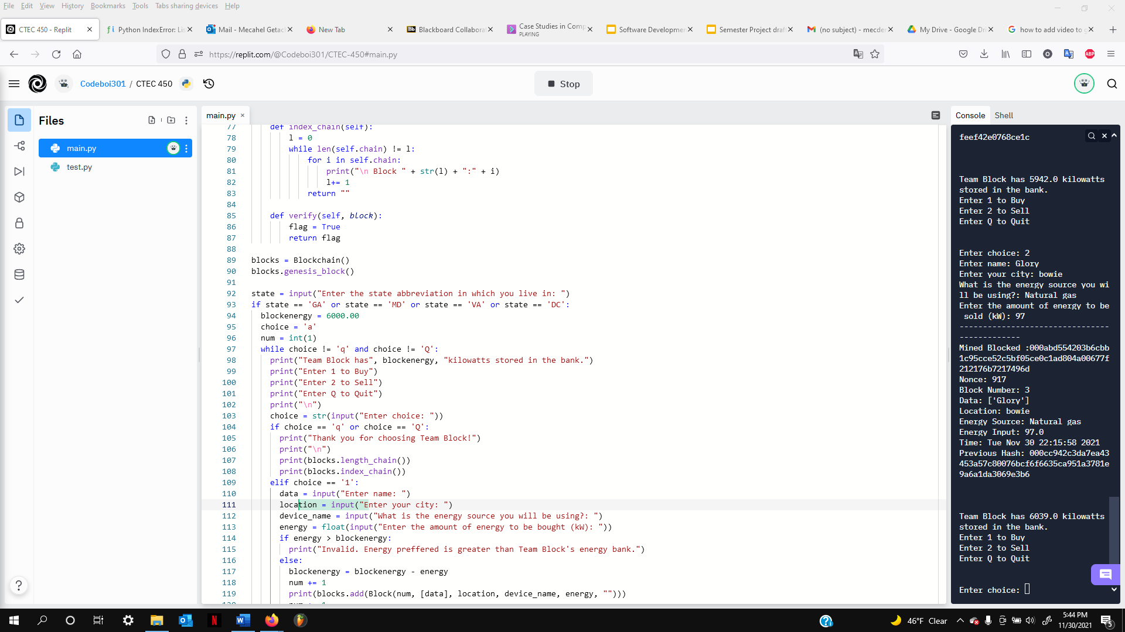
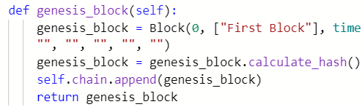
Source Code
Hashlib, json and time are necessary libraries in python that helps with length sequence, handle dataflow & real time value
Method that adds new block and verify the last block before use to create a new hash and chain
The class block will store & call all variables and the instance(self). We can outline new objects here
Self.chain variable keeps all the completed transactions in the block
Method that calculates and generate hash using sha256
IF statements used to determine if the user can enter the program, WHILE loops used if user wants to exit, given choices
Genesis block method used to build initial block to the chain and generate the hash for first block

Slide 8
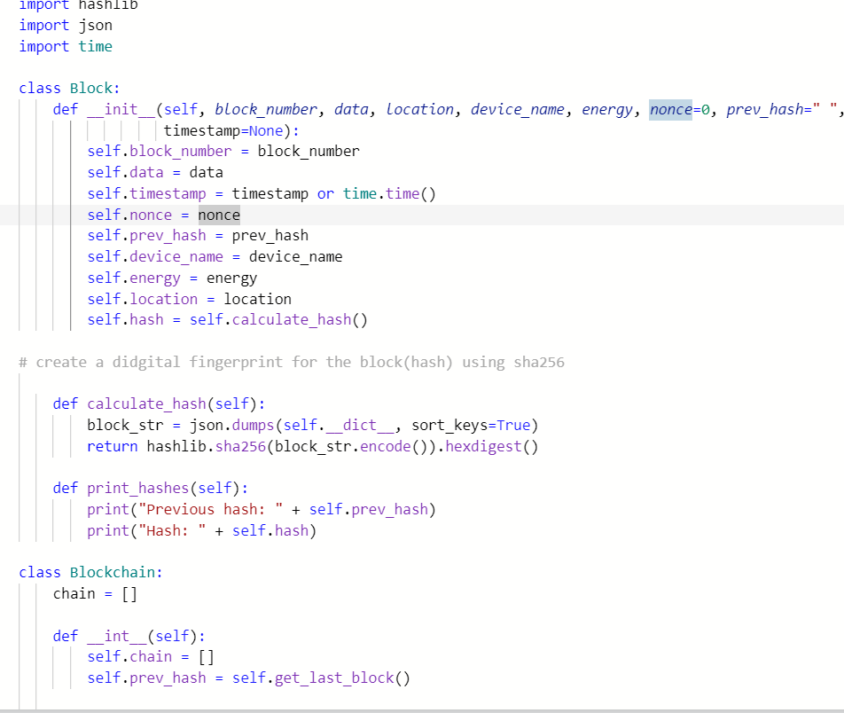
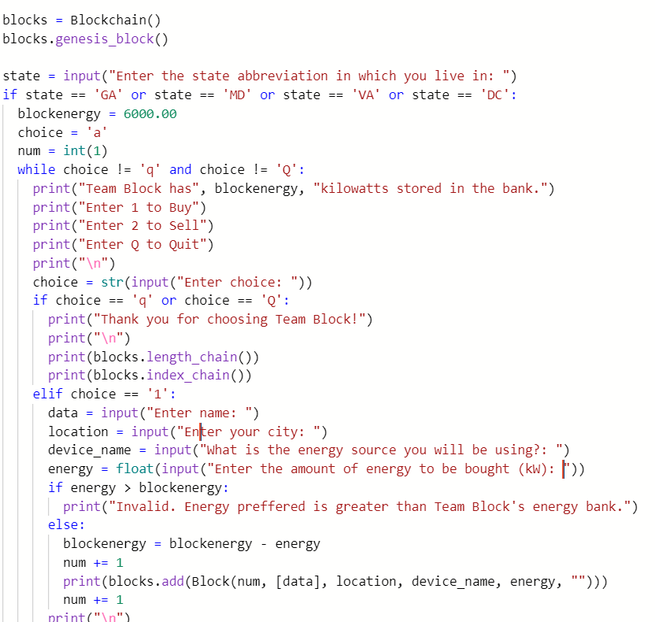
Source Code

Slide 9
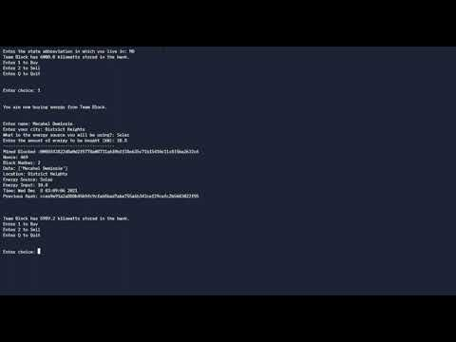
Program Demonstration
Program Demonstration
https://youtu.be/iaVeo7KqMIY

Slide 10
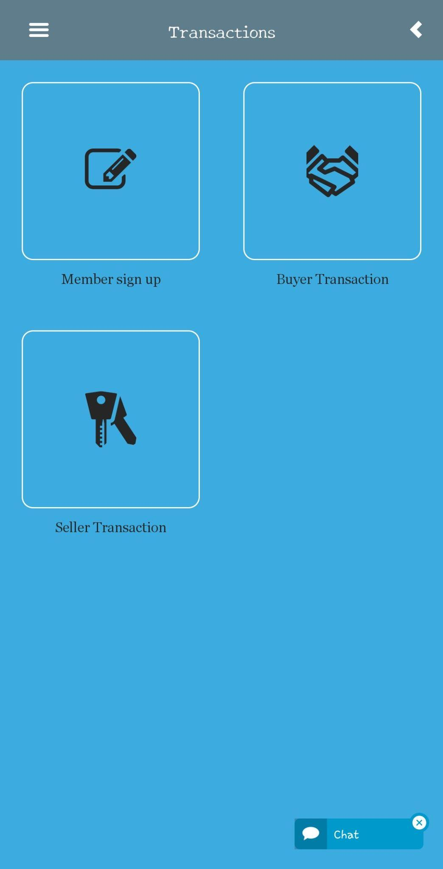
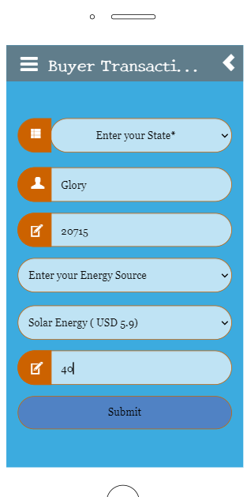
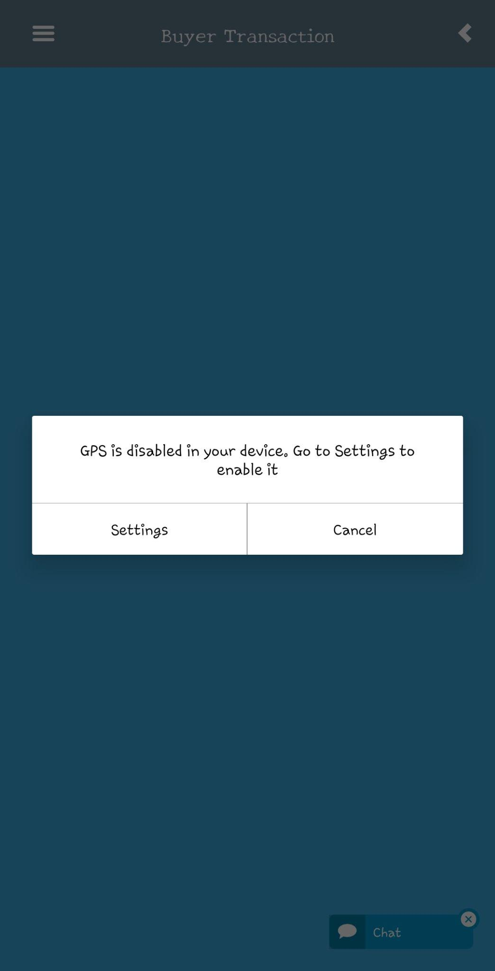
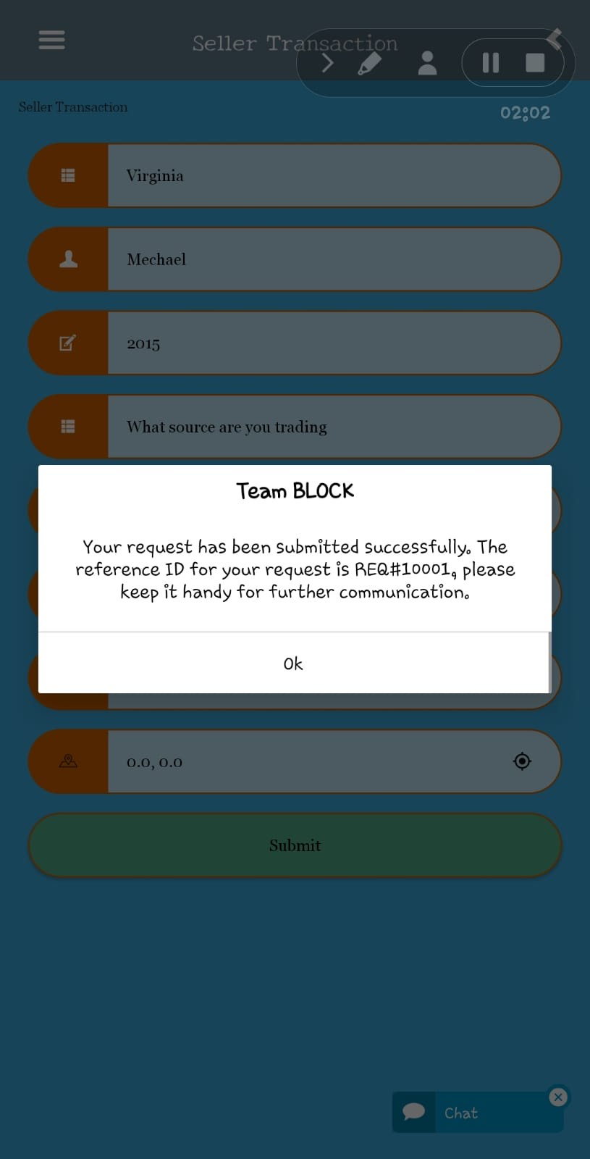
Graphical Demonstration

Slide 11


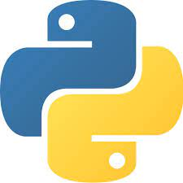

Software Used
Replit
Github
Python
PyCharm

Slide 12

Resources
https://www.geeksforgeeks.org/create-simple-blockchain-using-python/amp/
https://www.sciencedirect.com/science/article/pii/S2352484721003164#fig1
https://www.ricoh.com/technology/tech/089_blockchan
https://replit.com/join/cnnuypduxd-codeboi301

